Slide 1
Selling Masculinity
Created by Dr. Kris Acheson-Clair, CILMAR

Slide 2
Selling masculinity
How would you define masculinity?

Slide 3
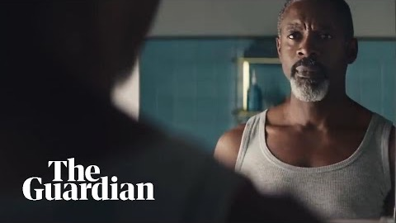
Selling masculinity
https://www.youtube.com/watch?v=UYaY2Kb_PKI

Slide 4
Selling masculinity
Discussion Questions:
What was your emotional response to this ad? What other emotional responses have you heard about or could you imagine?
What underlying cultural values and beliefs do you see in play in this ad?
Which co-cultural groups or social identities do you think are the intended audiences?
How do you see power and privilege critiqued in this ad?
How effective do you think the message was?

Slide 5
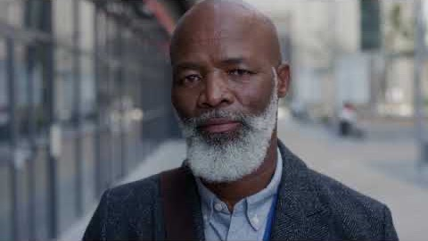
Selling masculinity
https://www.youtube.com/watch?v=x_HL0wiK4Zc

Slide 6
Selling masculinity
Discussion Questions:
What was your emotional response to this ad? What other emotional responses have you heard about or could you imagine?
What underlying cultural values and beliefs do you see in play in this ad?
Which co-cultural groups or social identities do you think are the intended audiences?
Think about this ad in relation to the first one – how are they similar and different? Which do you think is more effective?
Do you have any critiques to offer about the rhetoric used?

Slide 7
Selling masculinity
Debrief:
What are considered masculine traits in your culture? How are they similar or different to what is depicted in these two commercials?
What do each of these commercials imply or say about masculinity? How do you feel about their interpretations?
How strictly is masculinity enforced in your culture? That is, how acceptable is it in your culture for individuals to behave outside of gender norms?
Are you convinced by either of these commercials’ versions of masculinity? Why or why not?
What do you think about companies who brand based on social responsibility?

